Slide 1

Spacey Sequence diagram & Collaboration diagram
Group 2
1705095
1705096
1705097
1705102
1705104
1705120

Slide 2
Use Cases
1.Hosting
2.Renting
3.Payment(Mobile banking)
4.Payment(Cash)
5.Review
6.Complain For Host
7.Messaging

Slide 3
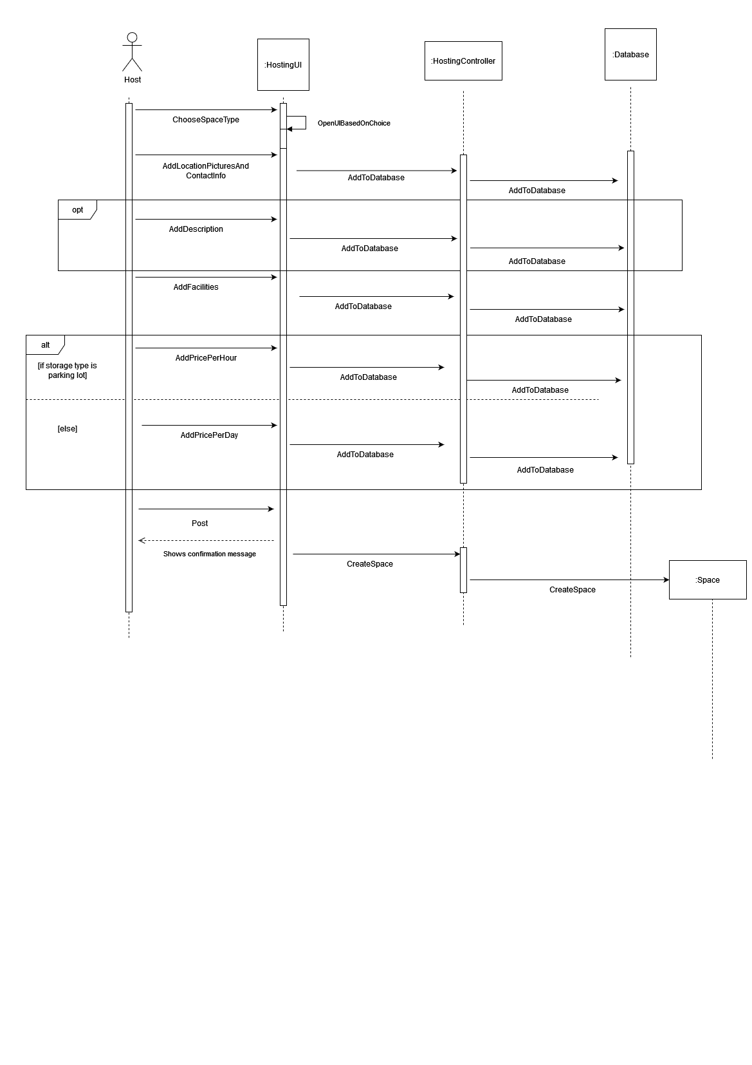
Hosting Sequence Diagram

Slide 4
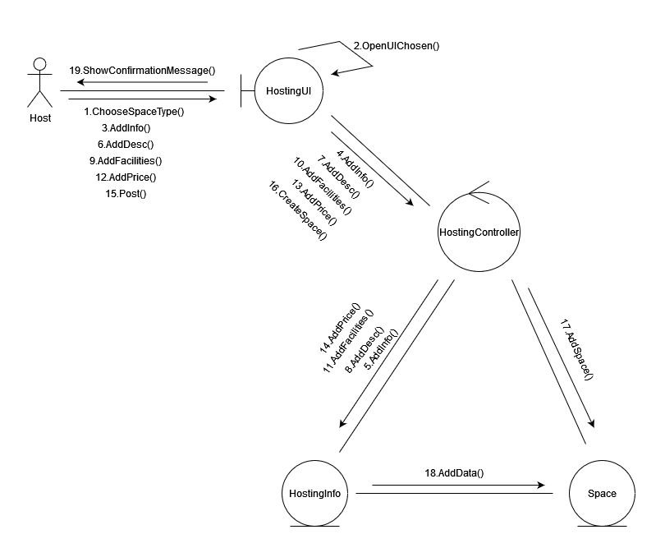
Hosting Collaboration Diagram

Slide 5
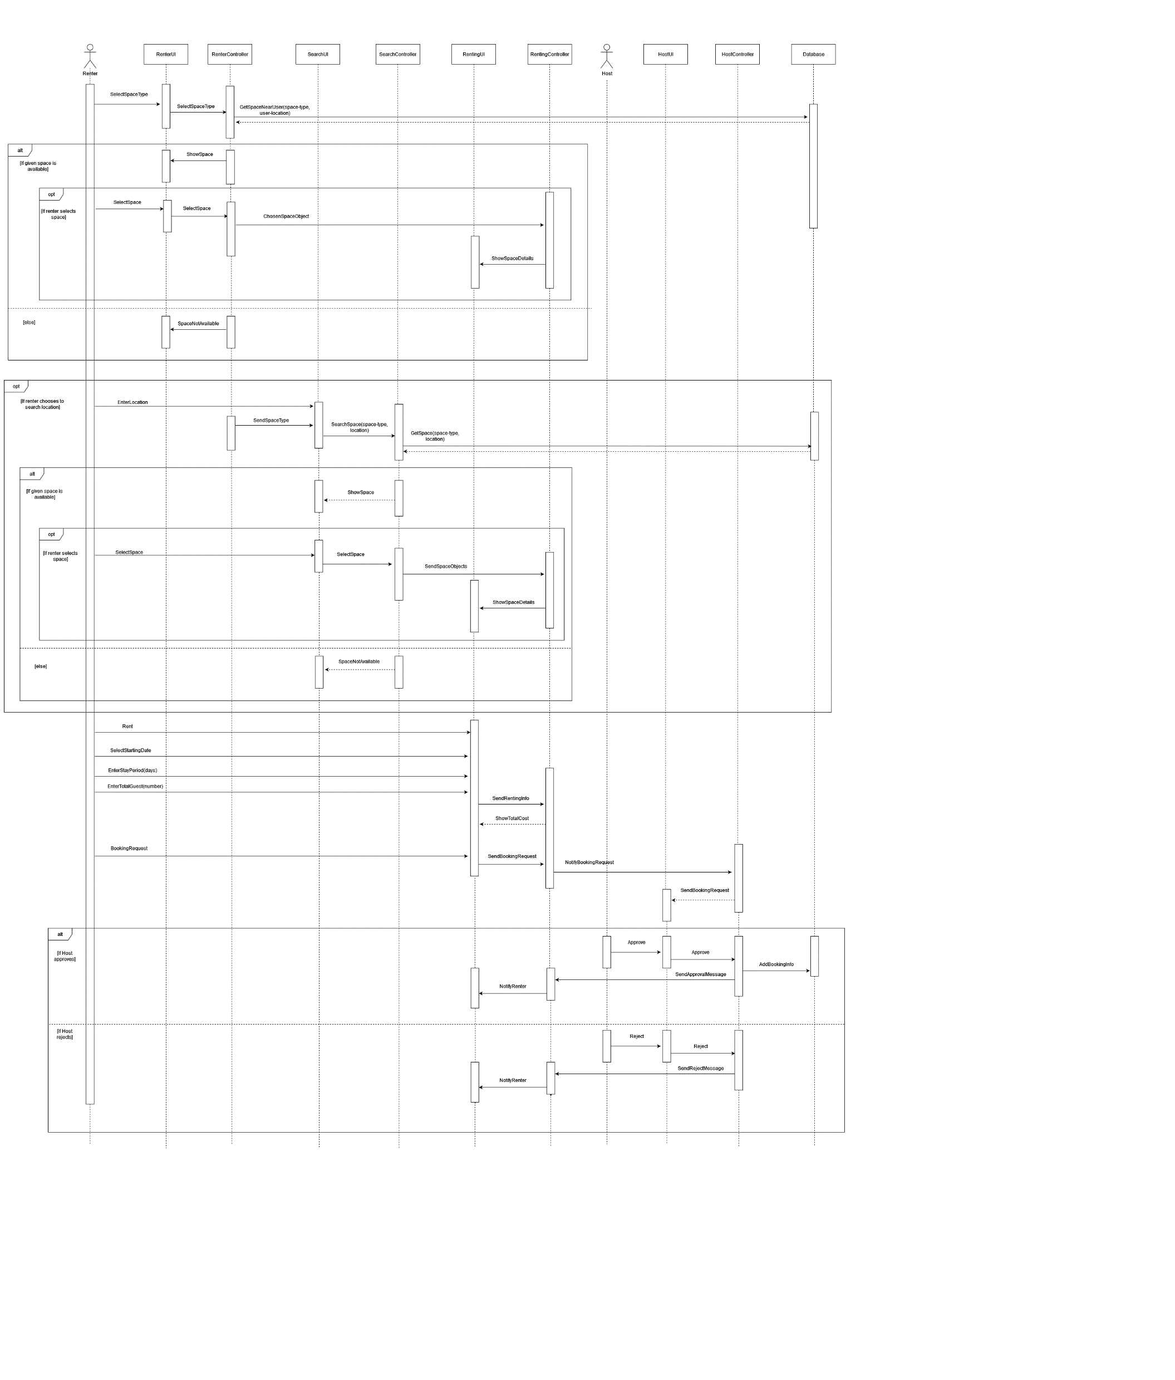
Renting Sequence Diagram

Slide 6


Slide 7


Slide 9
RENTING COLLABORATION

Slide 10
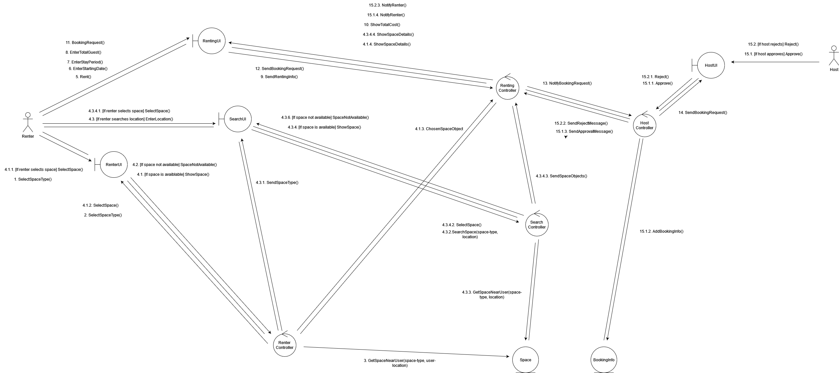

Slide 11
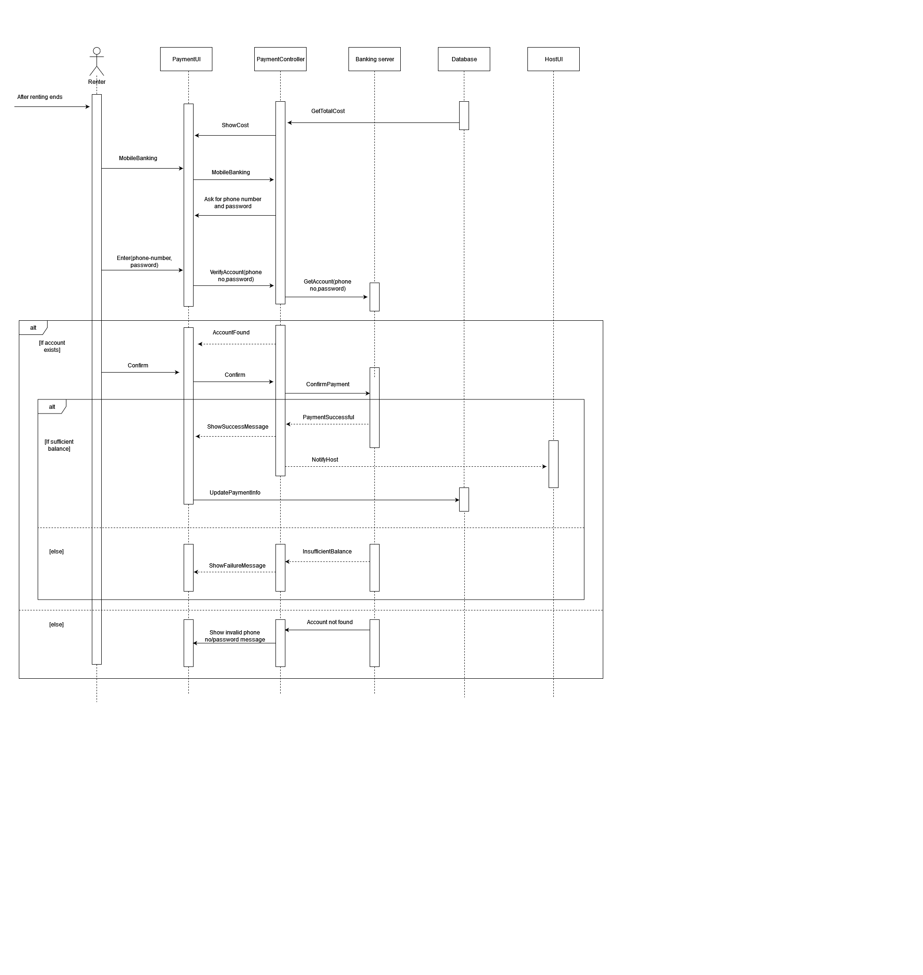
Payment (Mobile Banking) Sequence Diagram

Slide 12
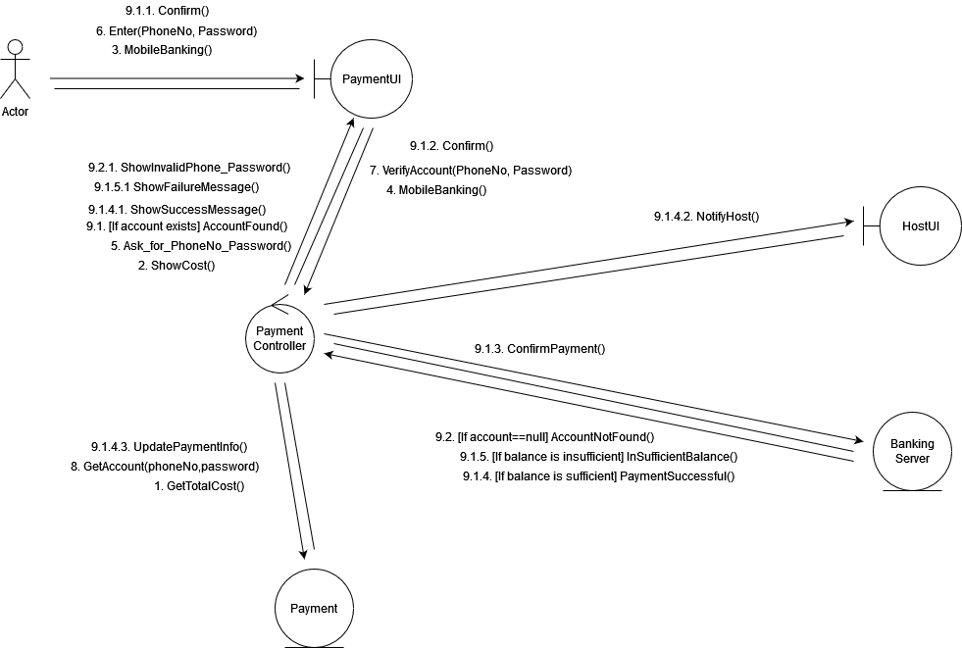
Payment (Mobile Banking) Collaboration Diagram

Slide 13
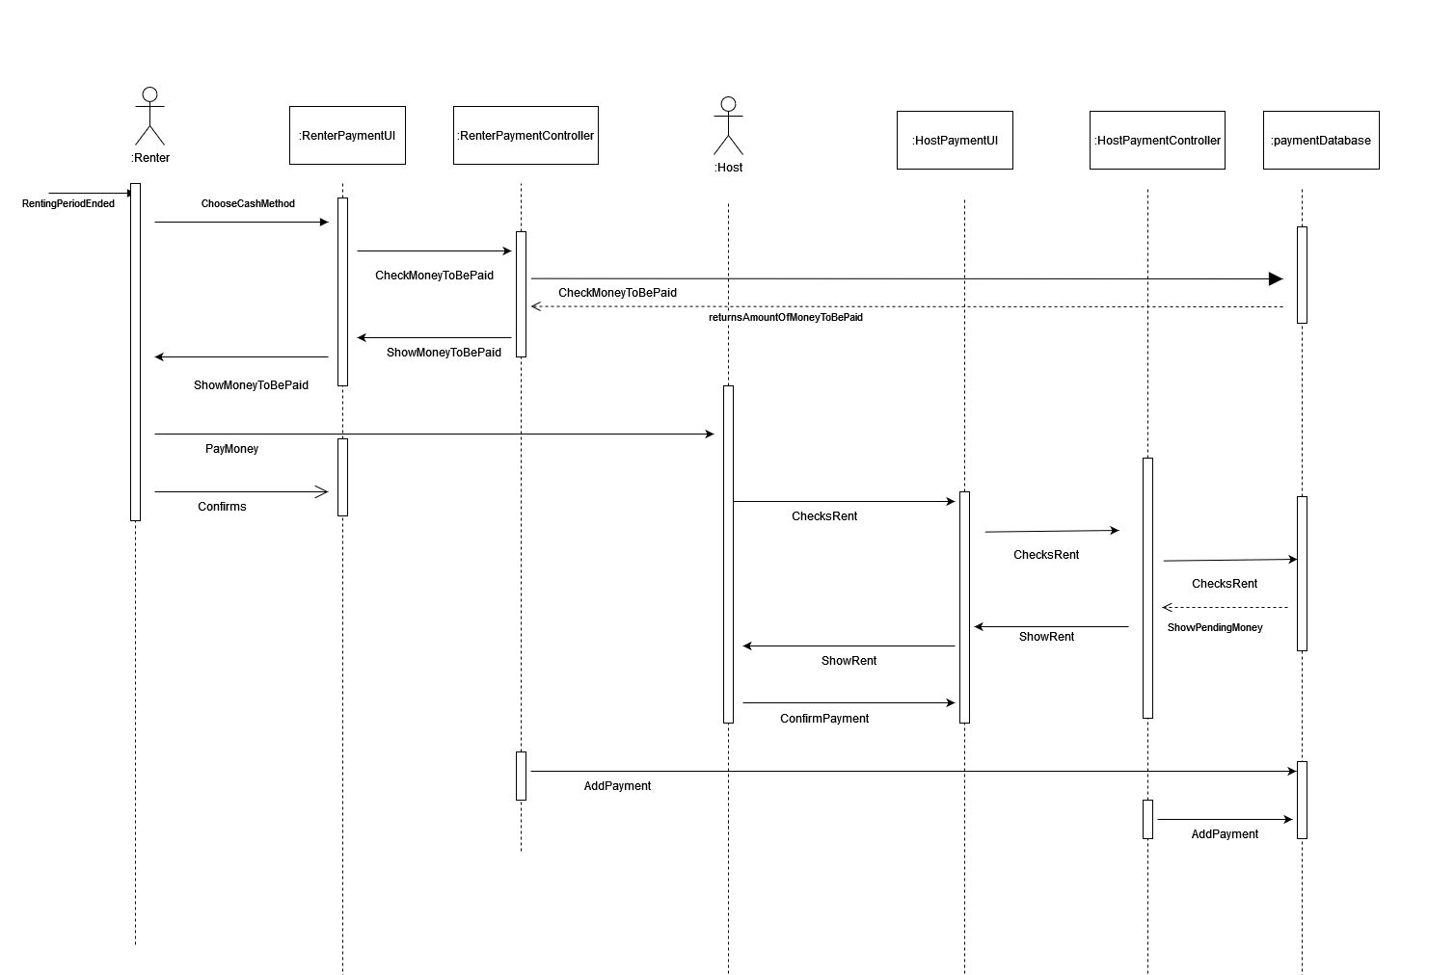
Payment (Cash) Sequence Diagram

Slide 14
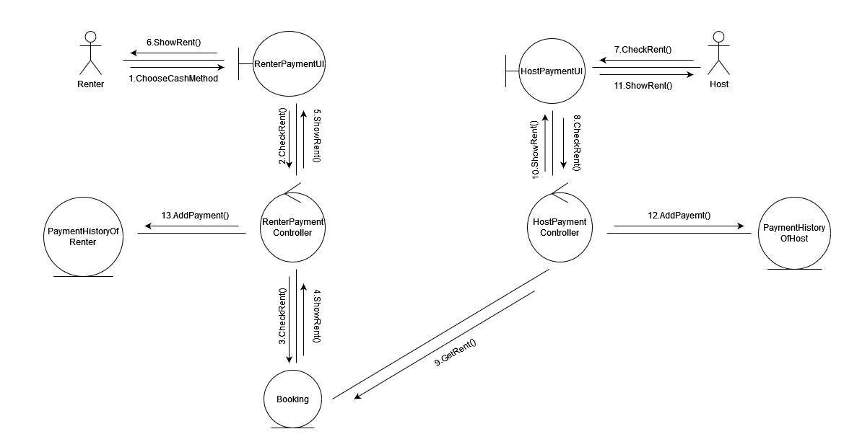
Payment (Cash) Collaboration Diagram

Slide 15
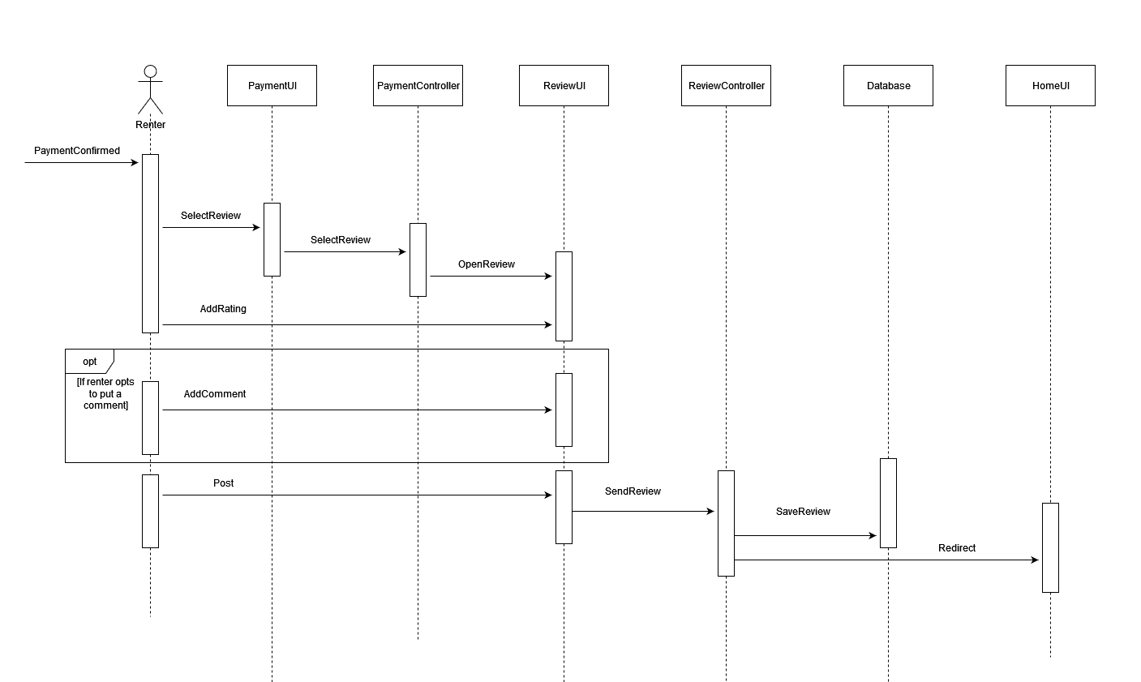
Review Sequence Diagram

Slide 16
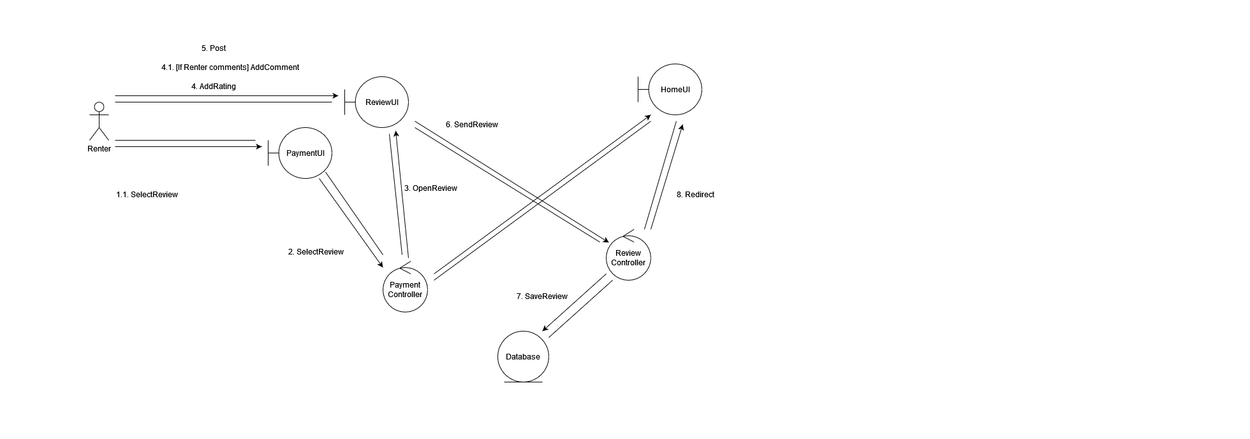
Review Collaboration Diagram

Slide 17
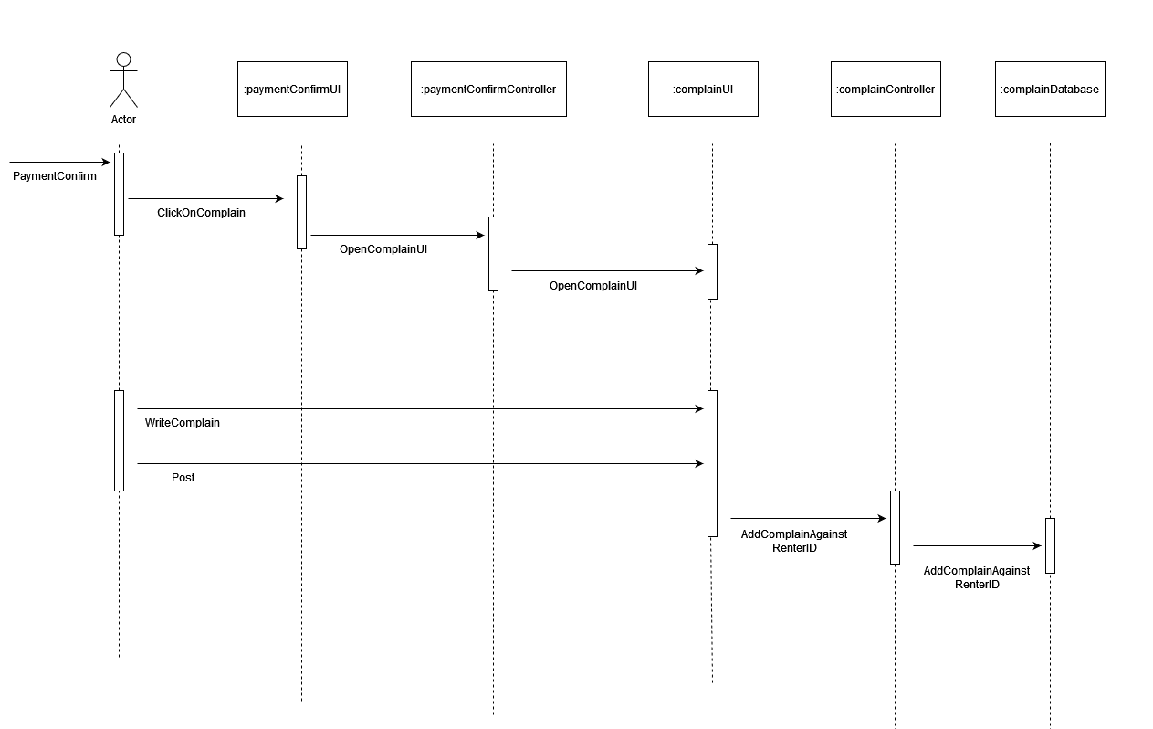
ComplainForHost Sequence Diagram

Slide 18
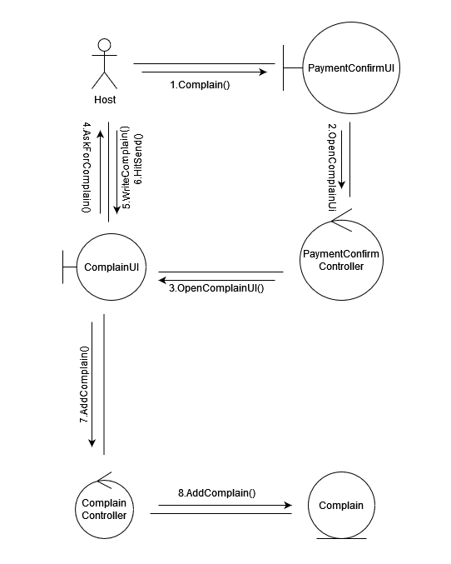
ComplainForHost Collaboration Diagram

Slide 19
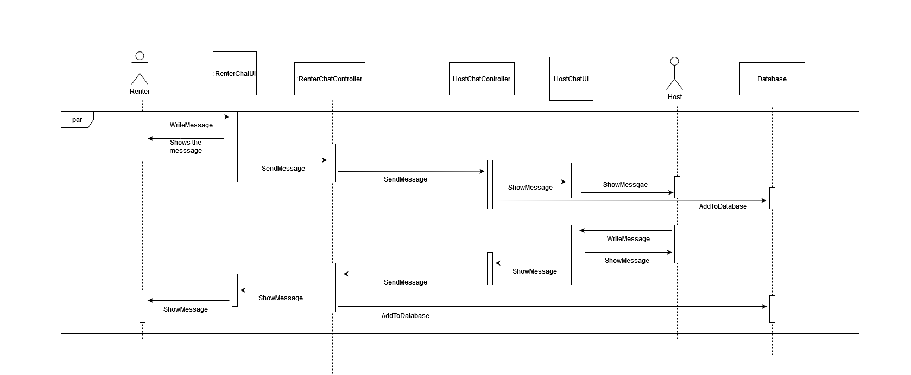
Messaging Sequence Diagram

Slide 20
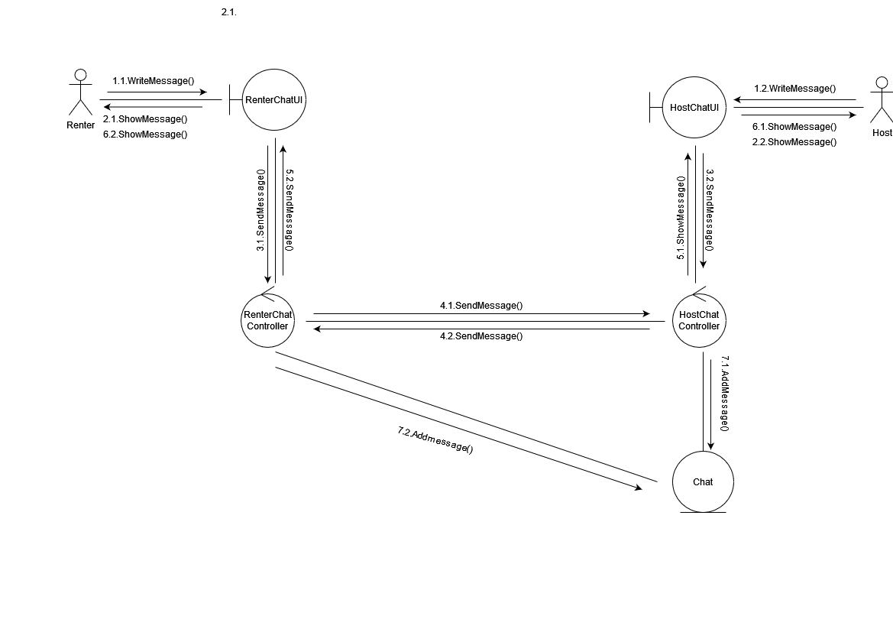
Messaging Collaboration Diagram

